Slide 1
Great Open Source Compliance For Everyone

Slide 2

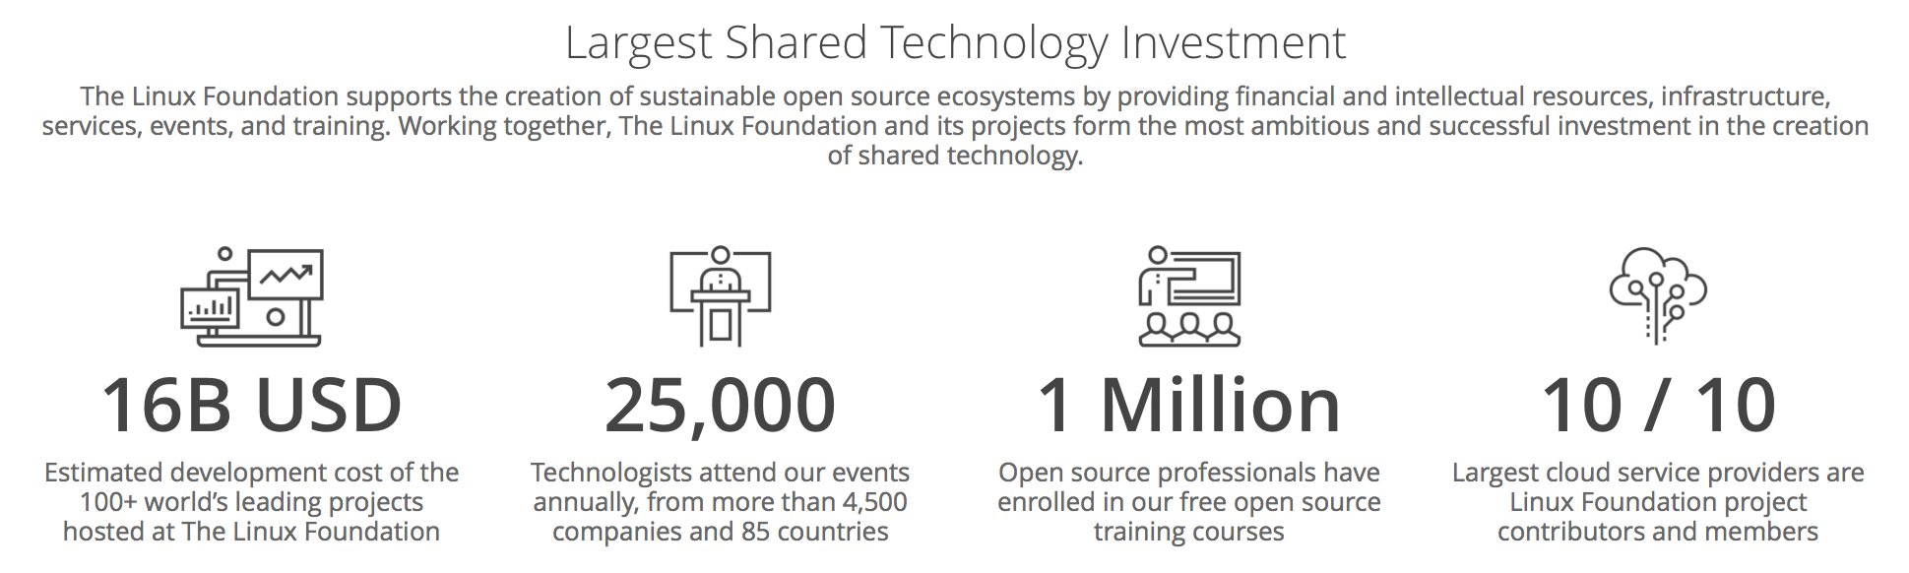
Notes:
To provide context for the OpenChain Project we need to look at the larger world of open source. The Linux Foundation, which hosts the OpenChain Project, also hosts 100 other projects driving open source adoption. Most of the projects create code, some create governance and compliance information. We are looking at 16 billion USD of collaborative development and tens of thousands of contributors alongside over 1,000 supporting companies.

Slide 3
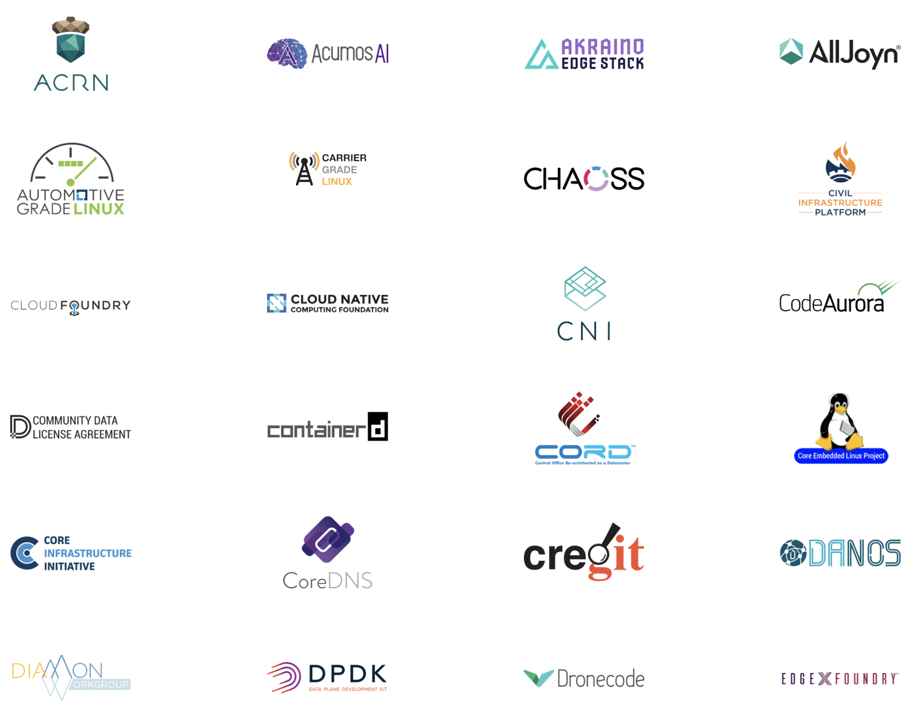
Notes:
Here is a whistlestop tour of Linux Foundation projects. We are not going to dwell on any single project. We are looking at scale.

Slide 4
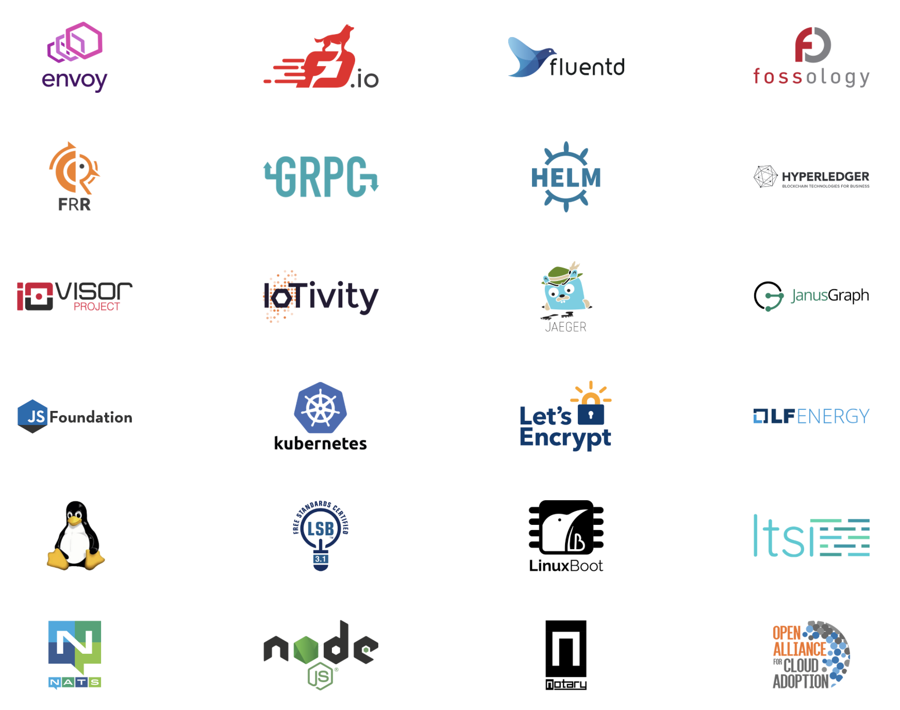
Notes:
Here’s more.

Slide 5
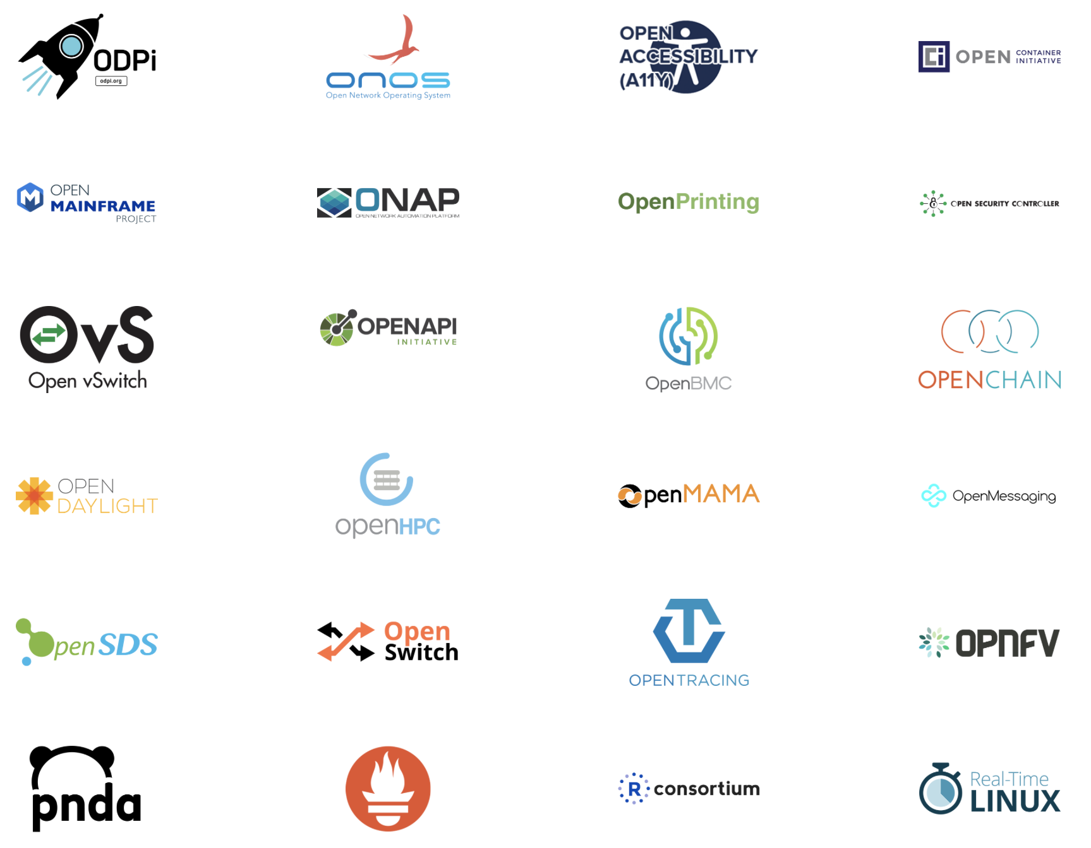
Notes:
And more.

Slide 6
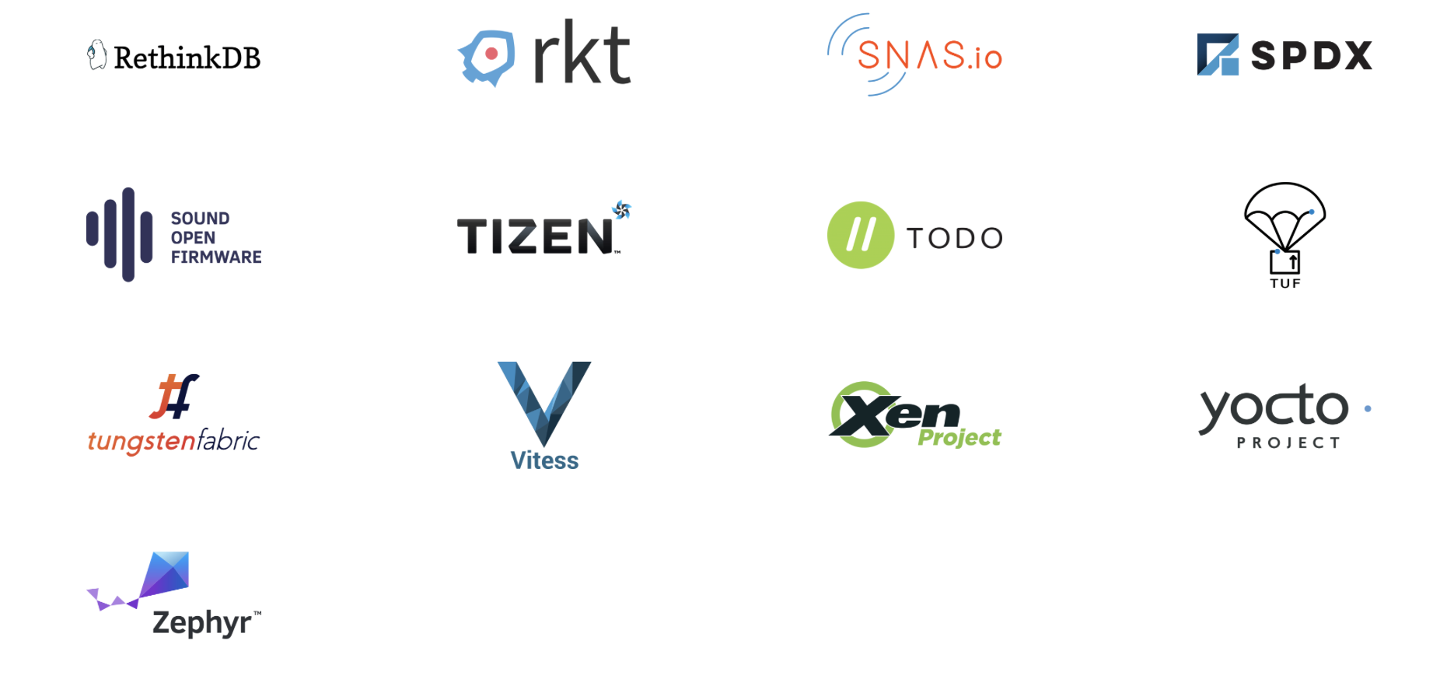
Notes:
And finally even more.

Slide 7
Compliance – A gateway to access
Notes:
Open source license compliance is a gateway to accessing projects like these. It is gateway to 16 billion dollars of code, platforms that can accelerate any market.

Slide 8
Let’s provide business context
Notes:
There is a clear business context for compliance. While often characterized as a boring legal matter, compliance is core to effective strategic engagement with open source technology.

Slide 9
Companies use open source and get billions of dollars of code
Notes:
Companies use open source and get billions of dollars of code

Slide 10
Open source code was created by other people
Notes:
This code was created by other people

Slide 11
How we respect their rights?
Notes:
One important question is how companies can respect third-party rights.

Slide 12
How do we meet our legal requirements?
Notes:
Another important question is how companies can meet their legal requirements.

Slide 13
The OpenChain Specification defines the requirements for a quality compliance program.
Notes:
The most important thing is that the OpenChain Specification defines the requirements for a quality compliance program.

Slide 14
Training
Policy
Process
Inbound
Outbound
Notes:
It defines the big picture, showing the inflection points where a company should have processes, policies or training.

Slide 15
Companies have the flexibility to decide the content of each specific process, policies and training.
Notes:
The OpenChain Specification confirms a company has open source processes, policies and training. Companies have the flexibility to decide the content of each specific process, policies and training.

Slide 16
The goal is to build trust by having organizations conformant with the OpenChain Specification.
Notes:
The goal is to build trust by having organizations conformant with the OpenChain Specification. We want organizations to meet the requirements of the OpenChain Specification and have built a healthy community to explain the value and to support new participants.

Slide 17
OpenChain Conformance allows organizations to show they meet these requirements.
Notes:
OpenChain Conformance allows organizations to show they meet these requirements. It provides the practical “yes/no” questions that help a company confirm it meets the OpenChain Specification.

Slide 18
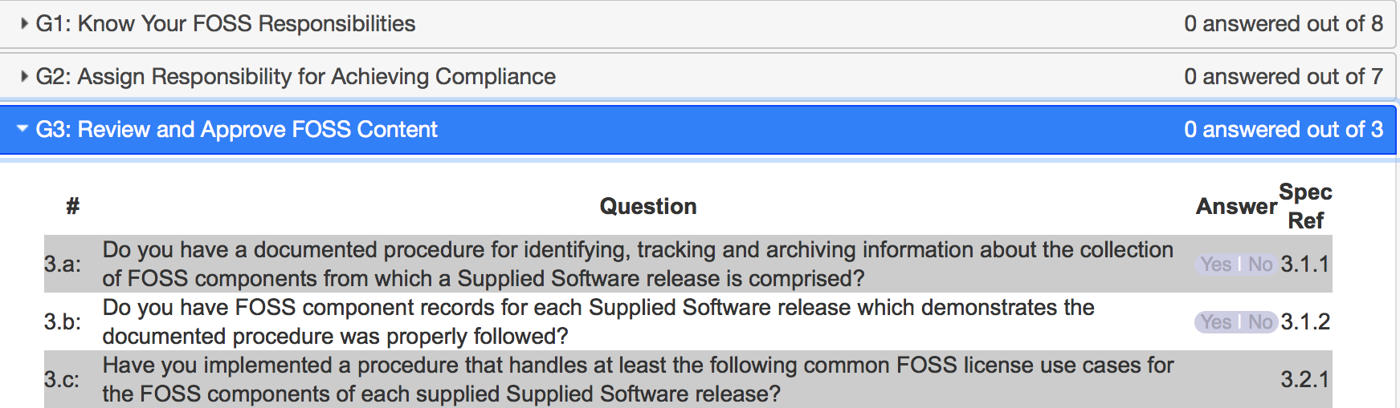
Notes:
Here is an example from our online Conformance web app. This app allows companies to self-certify to the OpenChain Specification.
There are five “Goals” – following the structure of the Specification – and each goal is accomplished by answering the questions contained inside. For example, Goal 3 contains three yes or no questions.

Slide 19
If a company can answer “Yes” to each question they are OpenChain Conformant.
Notes:
The exciting thing is how easy this is. If a company can answer Yes to each question they are OpenChain Conformant. This is a process companies can go through at their own pace and in private on the online Web App. Their conformance is only made public after they have passed the questionnaire and finalize their self-certification.

Slide 20
The OpenChain Curriculum provides reference open source processes and solutions.
Notes:
To support this journey – especially around filling in the gaps identified when going through the OpenChain Conformance process – companies can use the library of material in the OpenChain Curriculum.

Slide 21
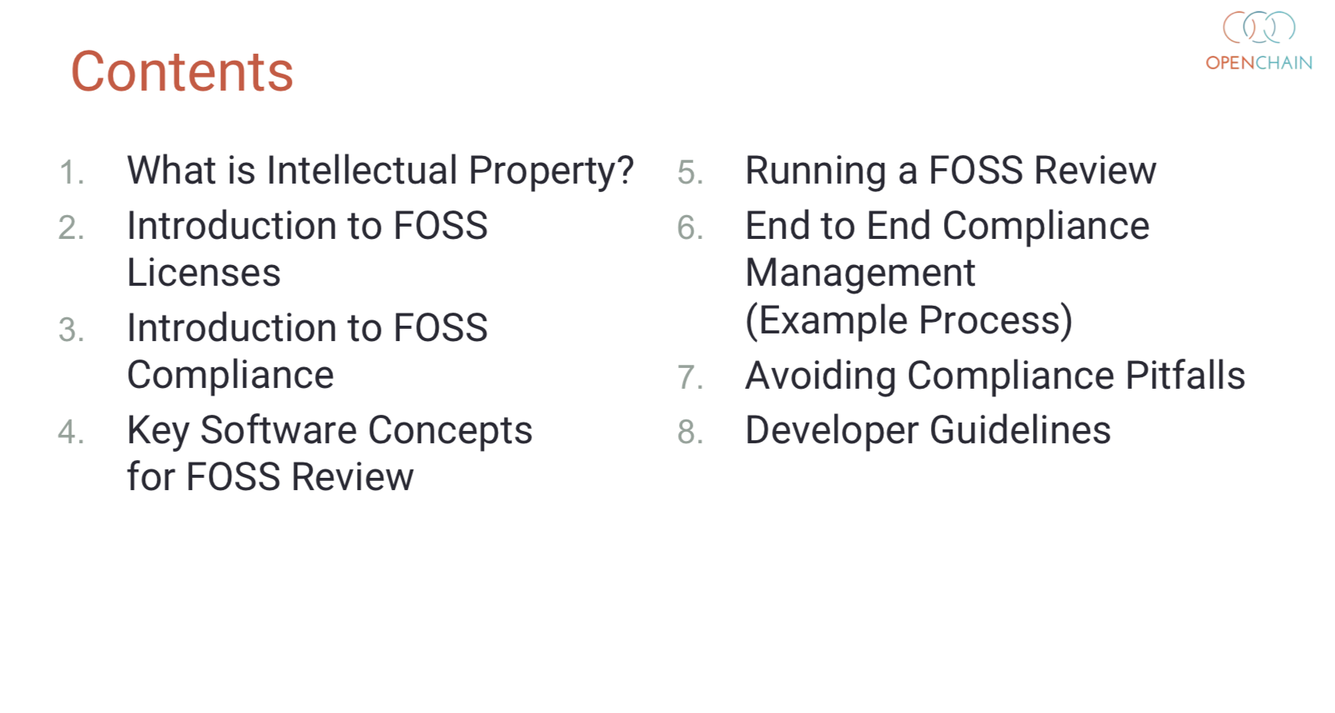
Notes:
Here is an example of our training slides. In eight chapters and 80 slides we have reference material guiding people from “what is intellectual property” to “developer guidelines.” This reference slide deck can be used by companies to help support their internal training.

Slide 22
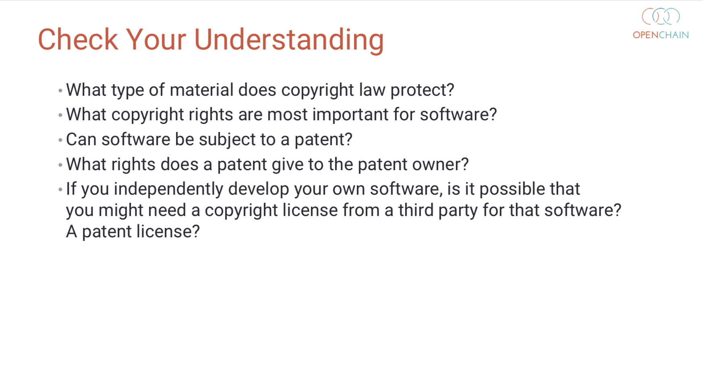
Notes:
Even though the deck is a compact 80 slides it also contains a simple and useful open source compliance exam. The end of all eight chapters have a set of “check your understanding” questions. Put all eight sections together and you have a great reference exam.

Slide 23
Work Teams supporting OpenChain:
Specification - Chaired by Mark Gisi (Wind River)
Conformance - Chaired by Miriam Ballhausen (SCA)
Curriculum - Chaired by Alexios Zavros (Intel)
Onboarding - Chaired by Nathan Kumagai (Qualcomm)
Notes:
The community is very inclusive and all of our day to day work is done via work teams that meet via phone twice a month. We do a lot of our work on these calls – where we publish slides and minutes – and we also do a lot of work on our mailing lists. Everyone is welcome to both. Indeed, we are actively seeking knowledge and contributors from all over the world. We are building a global standard and we want it to have a comprehensive global perspective.

Slide 24
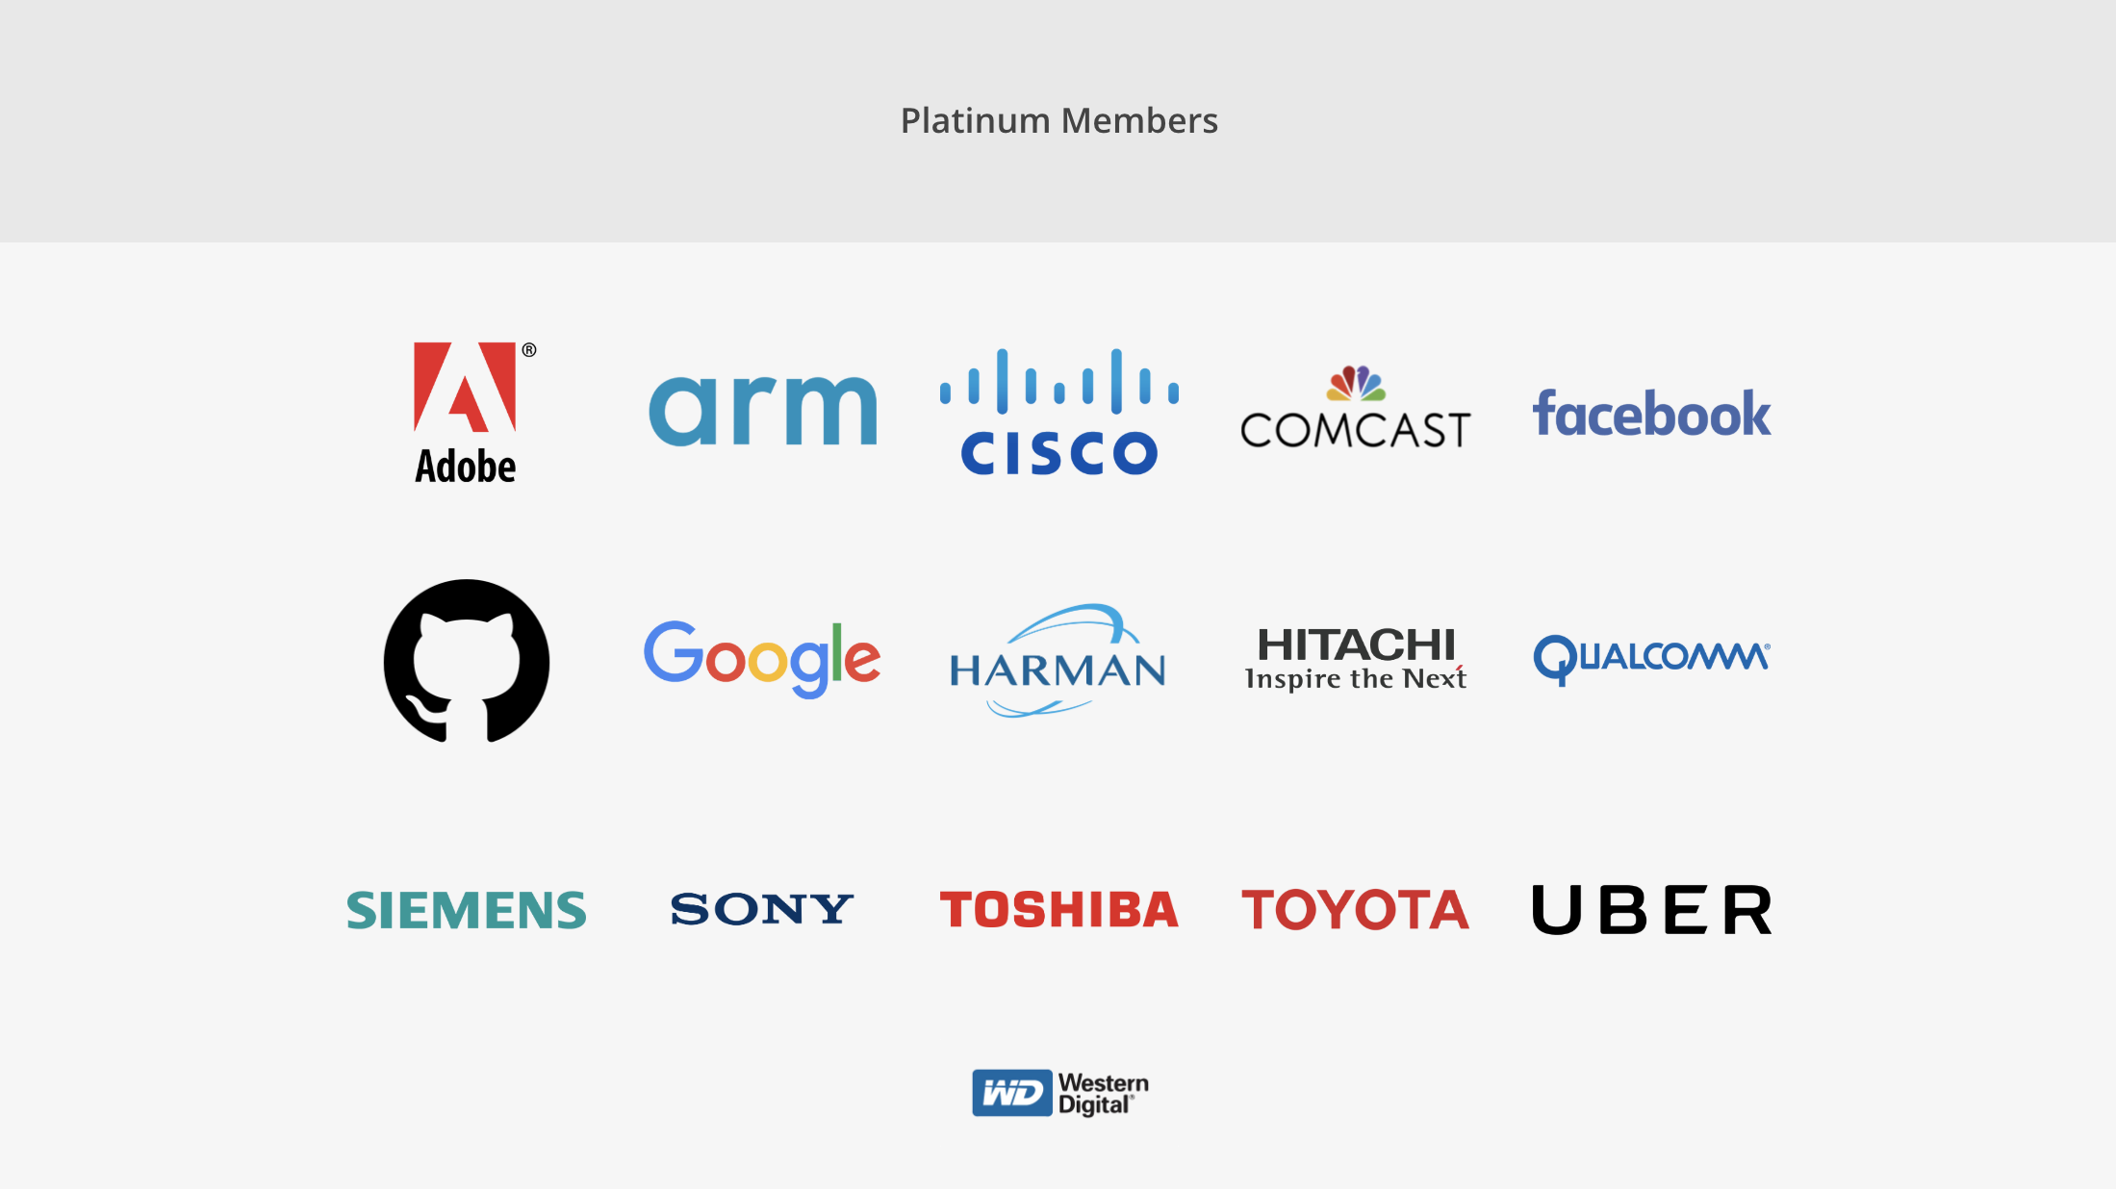
Notes:
There are a series of Platinum Member companies in the OpenChain Project. As you can see, they are diverse, with Adobe standing shoulder to shoulder with Toyota in establishing this standard for open source compliance.

Slide 25
Progress in 2018
International Partners - from law firms to certification authorities
Example: Moorcrofts - UK
Example: TÜV SÜD - Germany and Japan
Significant New Board Members
Example: Toshiba, Facebook, Google, Uber (more announcements shortly)
Significant New Community Members
Example: Microsoft
Example: Panasonic
A move towards formal standardization
Most likely PAS process for ISO - Launch ETA Q1 2020
Notes:
We have seen a lot of progress around the project in 2018 and expect to significantly increase our activities and adoption in 2019.

Slide 26
Be part of this
Join the community: https://www.openchainproject.org/community
Self-certify your organization: https://certification.openchainproject.org
Notes:
You are invited to be part of this. You can join our community by visiting our website, subscribing to a mailing list, or hopping on one of our calls. You can also access the self-certification web-app and check how your current overarching processes map to international norms. Naturally that is completely private until you want to declare OpenChain Conformance.

Slide 27
Contact: coughlan@linux.com
Notes:
And that’s it. OpenChain is the standard that explains the key requirements of quality open source compliance programs. It is open, it has a vibrant community, and we want to work with you. Thank you so much for your time. Any questions?

